Slide 1
Rock Vs Mine Prediction using Machine Learning
CS_3B_08

Slide 2
Overview
OBJECTIVE
Feasibility Study
Methodology
Tools/Technology Used

Slide 3
Objective
The project focuses on developing a solution for detecting underwater mines, a critical threat in modern maritime security. Underwater mines, used by enemy forces, pose a significant risk to naval and civilian vessels, disrupt essential trade routes, and threaten the environment and infrastructure. If detonated (explode), these mines can cause catastrophic damage (severe and widespread destruction that results in significant loss of life, property, or environmental harm), leading to the destruction of vessels, economic disruption, and long-lasting environmental consequences.

Slide 4
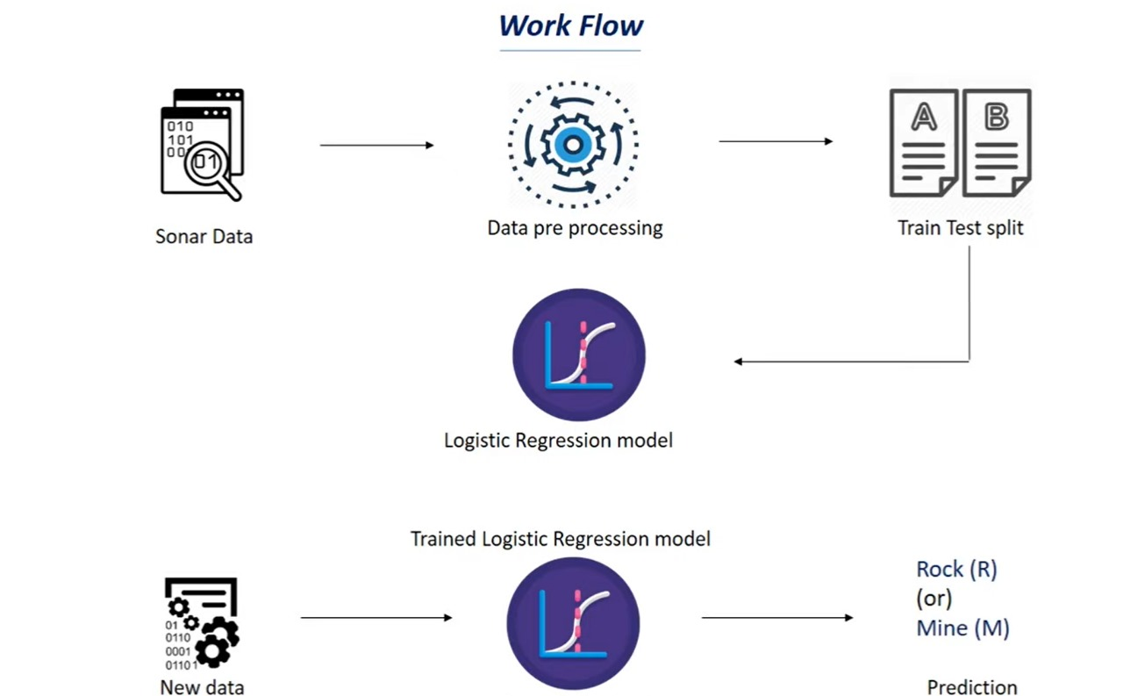
Working of Project

Slide 5
End Result and Benefit to End-User
Enhanced Detection Accuracy
Real-Time Threat Assessment
Increased Safety for Personnel
Operational Readiness for Naval Forces
Cost Savings and Resource Efficiency

Slide 6
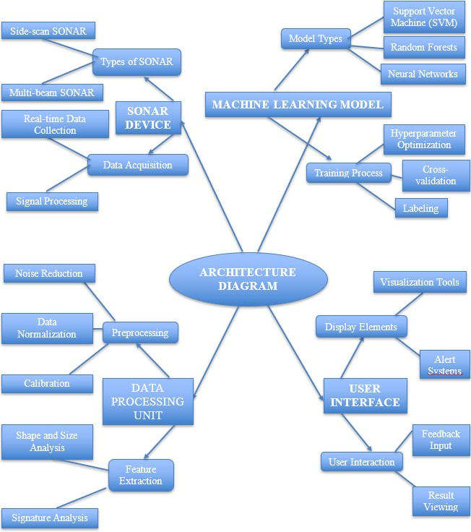
Architecture Diagram

Slide 7
Feasibility Study
Technical Feasibility Technical feasibility assesses whether the necessary technology and technical expertise are available or can be acquired to implement a project successfully.
Operational Feasibility Operational feasibility evaluates how well a proposed solution can fit within current operations.
Economic Feasibility Economic feasibility focuses on the financial viability of a project.
Legal Feasibility Legal feasibility reviews whether a project complies with all relevant laws and regulations.

Slide 8
Methodology
Literature Review and Requirement Analysis
System Design
Data Collection
Data Preprocessing
Model Development
Integration and Testing

Slide 9
Tools/Technology Used
Minimum Hardware Requirements
1. Hardware required for the development of the project.
2. CPU: Quad-core processor (Intel i5 or Ryzen 5 equivalent)
3. RAM: 16 GB DDR4
4. GPU: NVIDIA GTX 1660
5. HDD: 512 GB SSD or 1 TB HDD

Slide 10
Minimum Software Requirements
Software required for the development of the project.
OS : Windows 10/11 (64-bit) or Ubuntu 20.04 LTS or higher (Linux)
2. (a.) Python(Version: 3.8 or higher)
(b.)TensorFlow(Version: 2.x), PyTorch(Version: 1.7 or higher)
(c.)Scikit-learn(Version: 0.24 or higher)
(d.)NumPy(Version: 1.19 or higher)
(e.)Pandas(Version: 1.x), Docker(Version: 20.10 or higher), Visual Studio
Code(Version: Latest), PyCharm(Version: Latest), Jupyter Notebooks(Version:
Latest)

